Slide 1
Chapter 12

Slide 2
Objectives

Slide 3
Objectives (continued)

Slide 4
Two ways to create a regular expression object that will find “Babbage”

Slide 5
One method of a regular expression

Slide 6
How to create a case-insensitive regular expression

Slide 7
Terms

Slide 8
Special characters in regular expressions

Slide 9
How to match special characters

Slide 10
Types of characters in regular expressions

Slide 11
How to match types of characters

Slide 12
String positions in regular expressions

Slide 13
How to group and match subpatterns

Slide 14
Repeating patterns in regular expressions

Slide 15
How to match a repeating pattern

Slide 16
How to create a global regular expression

Slide 17
One property of a regular expression

Slide 18
How to create a multiline regular expression

Slide 19
Three string methods that you can use with regular expressions

Slide 20
How to use the search and match methods with a regular expression

Slide 21
How to use the search and match methods with a regular expression (continued)

Slide 22
How to use the replace method with a regular expression

Slide 23
Regular expressions for testing validity

Slide 24
Examples that use these expressions

Slide 25
A function that does complete validation of an email address

Slide 26
The syntax for creating a new Error object

Slide 27
A calculateFutureValue method that throws a new Error object

Slide 28
Two properties of Error objects

Slide 29
Other types of error objects that inherit from the Error type

Slide 30
The syntax for a try-catch statement

Slide 31
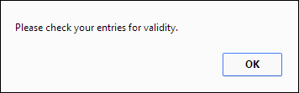
The message property of the error object that’s thrown by the calculateFutureValue function

Slide 32
A try-catch statement that rethrows an Error object to its calling function

Slide 33
Terms

Slide 34
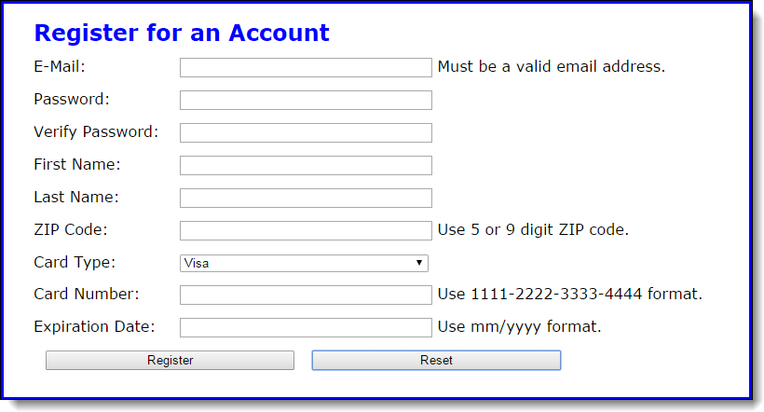
The Register form when it’s first displayed

Slide 35
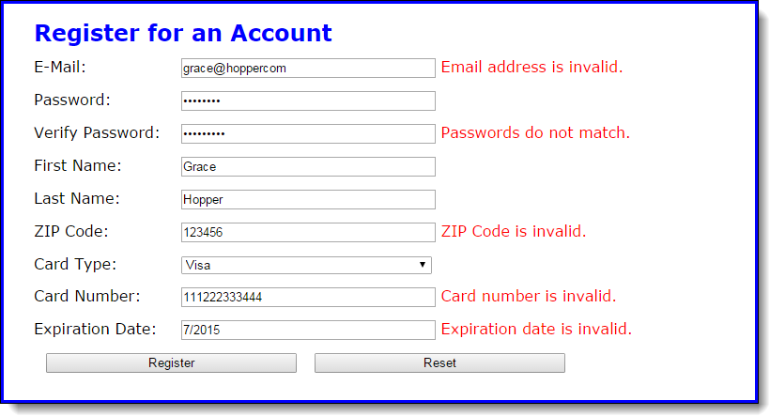
The Register form with error messages

Slide 36
The script elements in the head section that identify the libraries

Slide 37
The HTML for the main element of the document

Slide 38
The HTML (continued)

Slide 39
The HTML for a navigation section

Slide 40
Some of the CSS for the application

Slide 41
The library_navigate.js file

Slide 42
The library_fields.js file

Slide 43
The library_fields.js file (continued)

Slide 44
The library_validate.js file

Slide 45
The library_validate.js file (continued)

Slide 46
The library_validate.js file (continued)

Slide 47
The library_validate.js file (continued)

Slide 48
The library_validate_form.js file

Slide 49
The library_validate_form.js file (continued)

Slide 50
The library_validate_form.js file (continued)

Slide 51
The library_validate_form.js file (continued)

Slide 52
The library_validate_form.js file (continued)

Slide 53
The register.js file

Slide 54
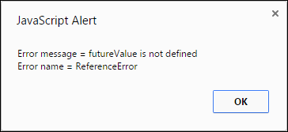
Exercise 12-1 Add exception handling to FV app

Slide 55
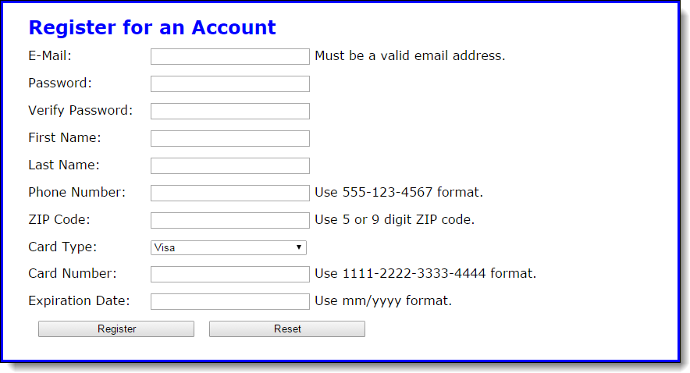
Exercise 12-2 Enhance the Register application

Slide 56
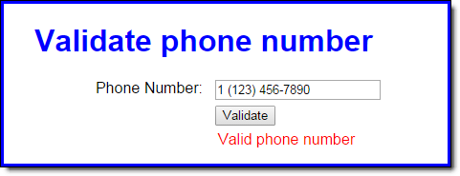
Extra 12-1 Adjust a regular expression pattern

Slide 57
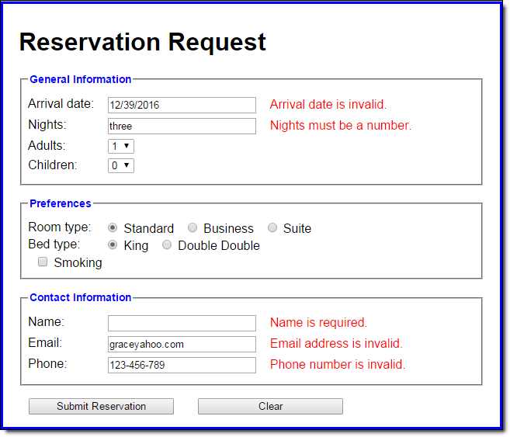
Extra 12-2 Add validation to a Reservation app

Slide 58
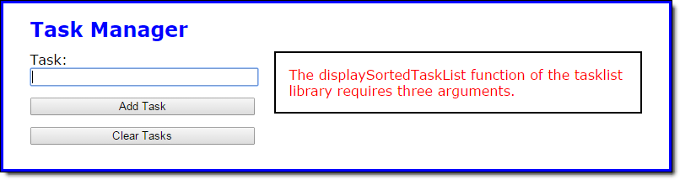
Short 12-1 Add exception handling to this app

